Slide 1
Strong Entity
A strong entity is not dependent on any other entity in the schema. A strong entity will always have a primary key.
Strong entities are represented by a single rectangle. The relationship of two strong entities is represented by a single diamond.
Various strong entities, when combined together, create a strong entity set.

Slide 2
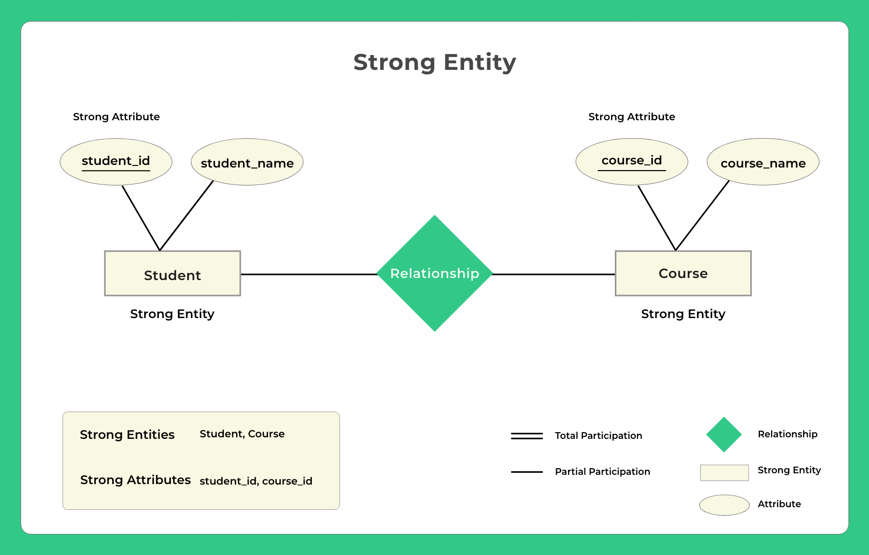

Slide 3
Example – A student entity can exist without needing any other entity in the schema or a course entity can exist without needing any other entity in the schema
A Strong entity is nothing but an entity set having a primary key attribute or a table that consists of a primary key column.
Representation
The strong entity is represented by a single rectangle.
The relationship between two strong entities is represented by a single diamond.

Slide 4
Weak Entity
The entity set which does not have sufficient attributes to form a primary key is called as Weak entity set.
Example 1 – A loan entity can not be created for a customer if the customer doesn’t exist.

Slide 5
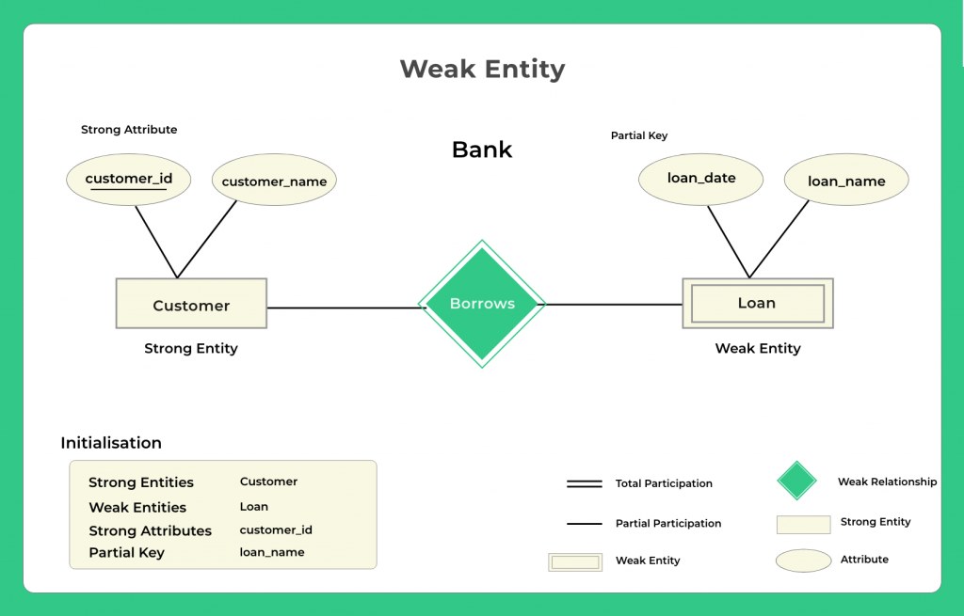

Slide 6
Representation
A double rectangle is used for representing a weak entity set
The double diamond symbol is used for representing the relationship between a strong entity and a weak entity which is known as identifying relationship

Slide 7
Difference
S.NO | Strong Entity | Weak Entity
1. | Strong entity always has a primary key. | While a weak entity has a partial discriminator key.
2. | Strong entity is not dependent on any other entity. | Weak entity depends on strong entity.
3. | Strong entity is represented by a single rectangle. | Weak entity is represented by a double rectangle.
4. | Two strong entity’s relationship is represented by a single diamond. | While the relation between one strong and one weak entity is represented by a double diamond.
5. | Strong entities have either total participation or not. | While weak entity always has total participation.

Slide 8
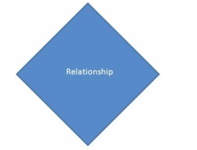
Relationships
Associations between entities are called relationships.
Example : An employee works for an organization. Here "works for" is a relation between the entities employee and organization.

Slide 9
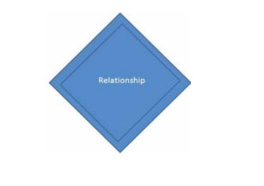
However in ER Modeling, To connect a weak Entity with others, you should use a weak relationship notation as given below

Slide 10
Degree of a Relationship
The number of entity types which took part in the entity relationship is called the degree of relationships.
three different types of degree of relationships,
Unary relationship
Binary relationship
Ternary relationship
N-ary relationship

Slide 11
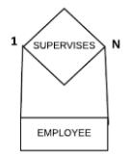
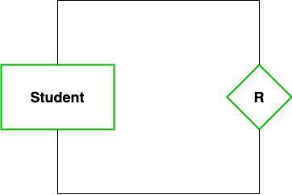
Unary relationship
It is the relationship between the instances of a single entity type. It is also called a recursive relationship.
two entities are of the same type
In a particular class, we have many students, there are monitors too. So, here class monitors are also students. Thus, we can say that only students are participating here. So the degree of such type of relationship is 1.

Slide 12
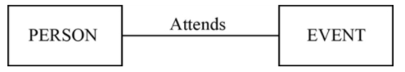
Binary relationship
It is the relationship between the instances of two different entity types. Two entities will participate in the relationship.
relationship between two different entities
Person and events are two different entity types which are related by using the relationship called “attends”.

Slide 13
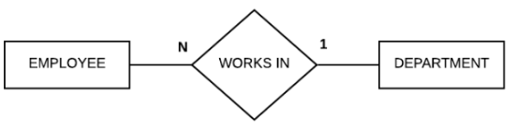
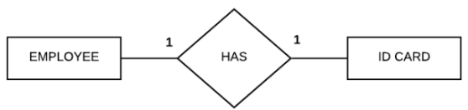
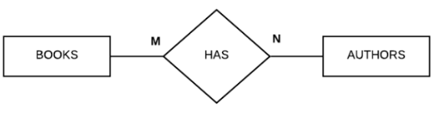

Slide 14
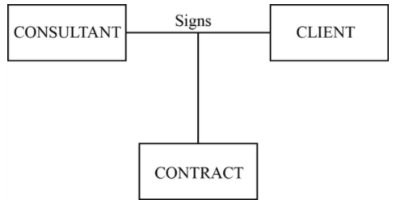
Ternary relationship
A simultaneous relationship between the instances of three entity types with unique attributes is called a ternary relationship.
relationship between three different entities
Consultant, client and contract are three different entities with different attributes.
These three entities are related with a single relationship called “signs”.

Slide 15
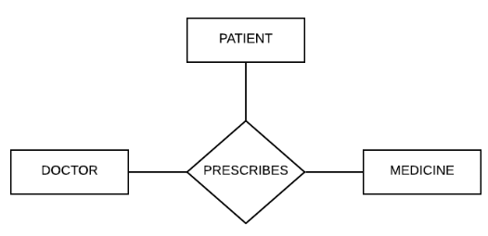
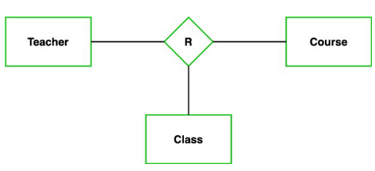

Slide 16
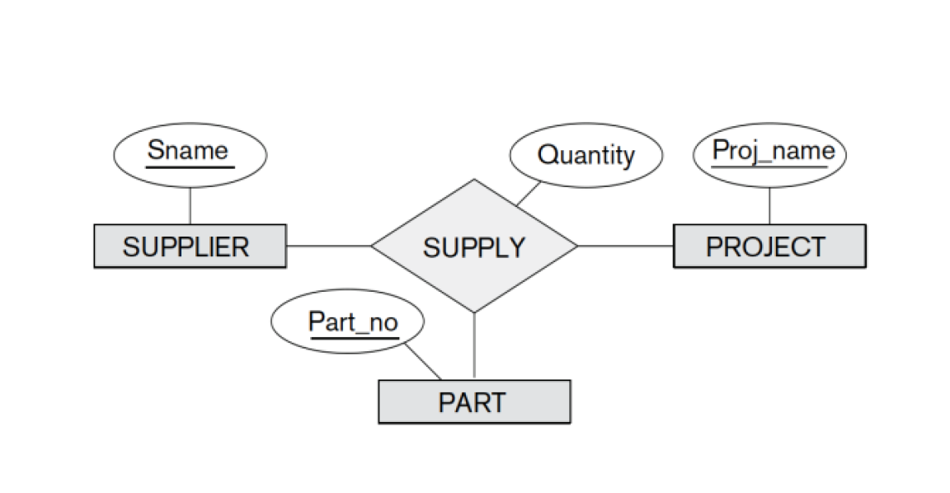

Slide 17
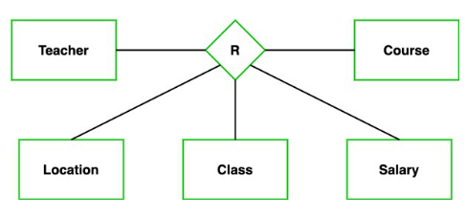
N-ary Relationship

Slide 18
Mapping Cardinalities
Express the number of entities to which another entity can be associated via a relationship set.
Most useful in describing binary relationship sets.
For a binary relationship set the mapping cardinality must be one of the following types:
One to one
One to many
Many to one
Many to many

Slide 19
One-to-one
One entity from entity set A can be associated with at most one entity of entity set B and vice versa.

Slide 20
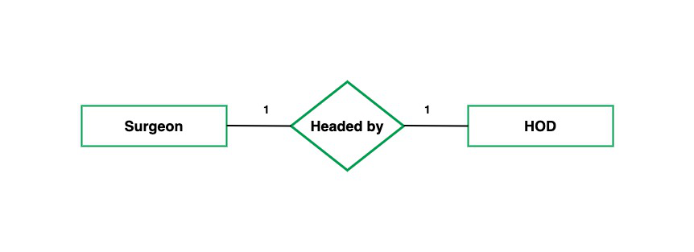
One employee is assigned with only one parking space and one parking space is assigned to only one employee. Hence it is a 1:1 relationship and cardinality is One-To-One (1:1).

Slide 21
One-to-many
One entity from entity set A can be associated with more than one entities of entity set B however an entity from entity set B, can be associated with at most one entity.

Slide 22

One organization can have many employees , but one employee works in only one organization. Hence it is a 1:N relationship and cardinality is One-To-Many (1:N).

Slide 23
Many-to-one
More than one entities from entity set A can be associated with at most one entity of entity set B, however an entity from entity set B can be associated with more than one entity from entity set A.

Slide 24
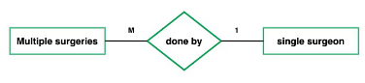
One employee works in only one organization But one organization can have many employees. Hence it is a M:1 relationship and cardinality is Many-to-One (M :1).

Slide 25
Many-to-Many (M:N)
One entity from A can be associated with more than one entity from B and vice versa.

Slide 26
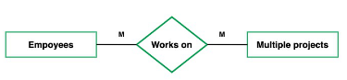
One student can enroll for many courses and one course can be enrolled by many students. Hence it is a M:N relationship and cardinality is Many-to-Many (M:N).

Slide 27
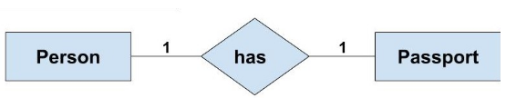
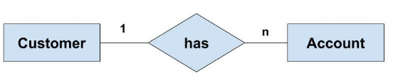
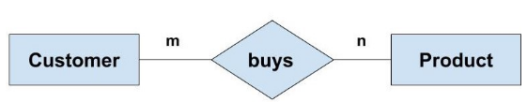

Slide 28
Participation Constraint / Minimum cardinality constraint
In a Relationship, Participation constraint specifies the presence of an entity when it is related to another entity in a relationship type.
This constraint specifies the number of instances of an entity that are participating in the relationship type.
There are two types of Participation constraint:
Total participation
Partial participation

Slide 29
Participation Constraint
1. Total Participation – Each entity in the entity set must participate in the relationship. If each student must enroll in a course, the participation of student will be total. Total participation is shown by double line in ER diagram.
2. Partial Participation – The entity in the entity set may or may NOT participate in the relationship. If some courses are not enrolled by any of the student, the participation of course will be partial.

Slide 30
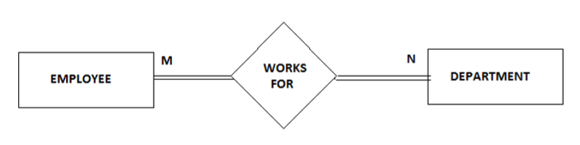
Total Participation
Each entity in the entity set is involved in at least one relationship in a relationship set i.e. the number of relationship in every entity is involved is greater than 0.
Consider two entities Employee and Department related via Works_For relationship. Now, every Employee works in at least one department therefore an Employee entity exist if it has at least one Works_For relationship with Department entity. Thus the participation of Employee in Works_For is total relationship. Total Participation is represented by double line in ER diagram.

Slide 31
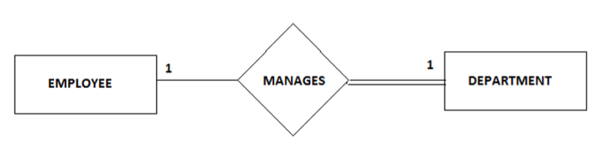
Partial Participation
Each entity in entity set may or may not occur in at least one relationship in a relationship set.
For example: Consider two entities Employee and Department and they are related to each other via Manages relationship. An Employee must manage a Department, he or she could be the head of the department. But not every Employee in the company manages the department. So, participation of employee in the Manages relationship type is partial i.e. only a particular set of Employees will manage the Department but not all.

Slide 32
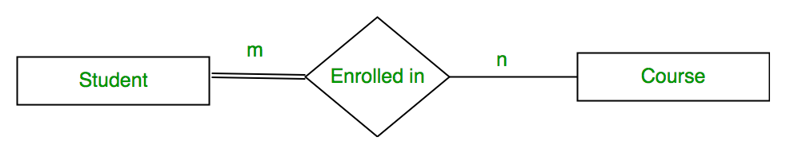
The diagram depicts the ‘Enrolled in’ relationship set with Student Entity set having total participation and Course Entity set having partial participation.

Slide 33
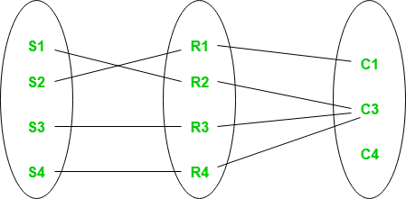
Using set, it can be represented as,
Every student in Student Entity set is participating in relationship but there exists a course C4 which is not taking part in the relationship.

Slide 34
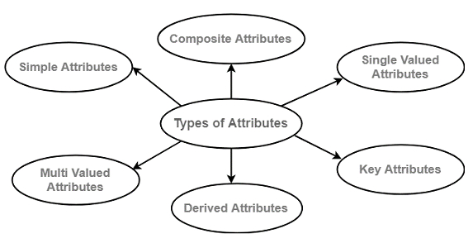

Slide 35
Composite attribute
It can be divided into smaller sub parts, each sub part can form an independent attribute. Example- Name
Simple or Atomic attribute
Attributes that cannot be further subdivided are called atomic attributes.
Example- Phone Number, Pin code
Single valued Attribute
Attributes having a single value for a particular item is called a single valued attribute. Example: Room Number
Multi-valued Attribute
Attribute having a set of values for a single entity is called a multi-valued attribute.
For example − e-mail, Tel.No, Hobbies

Slide 36
Derived Attributes or stored Attributes
When one attribute value is derived from the other is called a derived attribute.
For example: Age can be derived from date of birth, where,
Age is the derived attribute.
DOB is the stored attribute.
Complex Attribute
Nesting of composite and multi-valued attributes forms a complex attribute.
For example
If a person has more than one house and each house has more than one phone. Then, that attribute phone is represented as a complex attribute.

Slide 37
What are Keys in DBMS?
KEYS in DBMS is an attribute or set of attributes which helps you to identify a row (tuple) in a relation (table).
They allow you to find the relation between two tables.
Keys help you uniquely identify a row in a table by a combination of one or more columns in that table.
Key is also helpful for finding unique record or row from the table.

Slide 38
Keys in DBMS
Primary Key
Candidate Key
Super Key
Alternate Key
Foreign Key / Referential Integrity
Composite Key
Compound Key
Artificial key / Surrogate key

Slide 39
A Superkey is a group of single or multiple keys which identifies rows in a table.
It is the combination of all possible attributes that can uniquely identify the rows from the given relation.
A Super key may have additional attributes that are not needed for unique identification.
It is Superset of candidate key.
A table can have many super-keys.

Slide 40
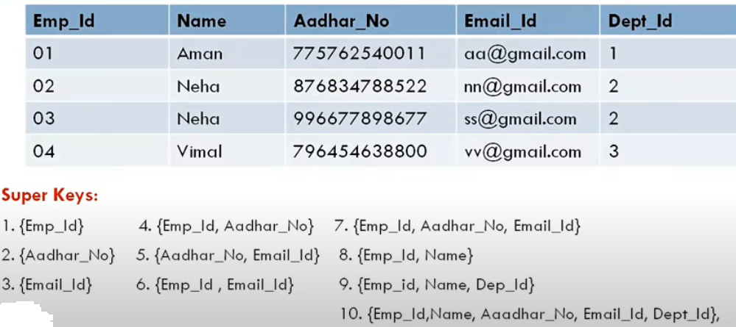
Super Key

Slide 41
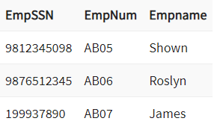
EmpSSN and EmpNum name are superkeys

Slide 42
CANDIDATE KEY / Minimal Super Key / Super Key with no redundant attributes
CANDIDATE KEY in SQL is a set of minimum attributes (from super key) that uniquely identify tuples in a table. Candidate Key is a super key with no repeated attributes. The Primary key should be selected from the candidate keys. Every table must have at least a single candidate key. A table can have multiple candidate keys but only a single primary key.
Properties of Candidate key:
It must contain unique values
Candidate key in SQL may have multiple attributes
Must not contain null values
It should contain minimum fields to ensure uniqueness
Uniquely identify each record in a table

Slide 43
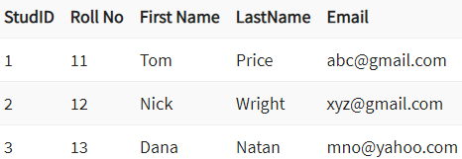
In the given table Stud ID, Roll No, and email are candidate keys which help us to uniquely identify the student record in the table.

Slide 44
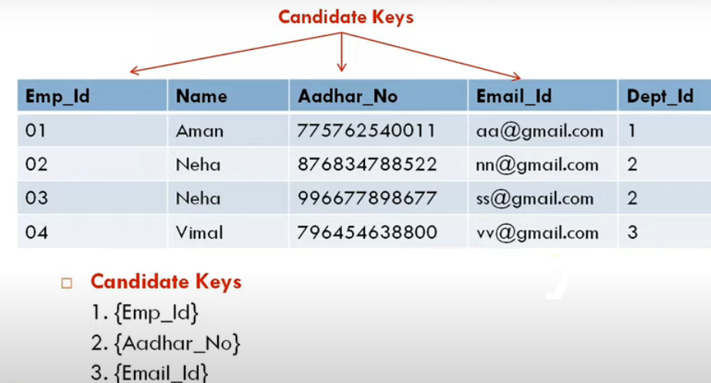

Slide 45
PRIMARY KEY in DBMS is a column or group of columns in a table that uniquely identify every row in that table. The Primary Key can’t be a duplicate meaning the same value can’t appear more than once in the table. A table cannot have more than one primary key.
Unique + Not Null
Rules for defining Primary key:
Two rows can’t have the same primary key value
It must for every row to have a primary key value.
The primary key field cannot be null.
The value in a primary key column can never be modified or updated if any foreign key refers to that primary key.

Slide 46
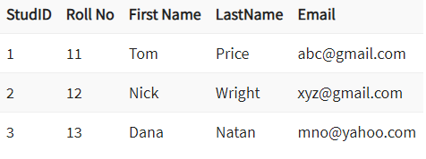
In the following example, StudID is a Primary Key.
A table can have one Primary Key but many unique constraints.

Slide 47
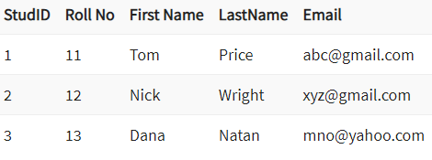
ALTERNATE KEYS is a column or group of columns in a table that uniquely identify every row in that table. A table can have multiple choices for a primary key but only one can be set as the primary key. All the keys which are not primary key are called an Alternate Key.
StudID, Roll No, Email are qualified to become a primary key. But since StudID is the primary key, Roll No, Email becomes the alternative key.

Slide 48
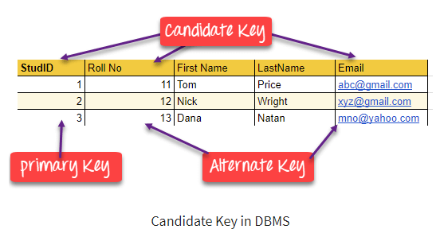

Slide 49
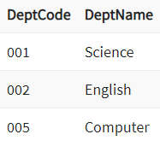
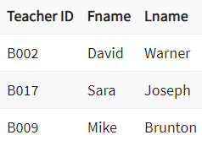
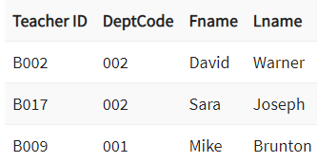
FOREIGN KEY is a column that creates a relationship between two tables. The purpose of Foreign keys is to maintain data integrity and allow navigation between two different instances of an entity. It acts as a cross-reference between two tables as it references the primary key of another table.
This concept is also known as Referential Integrity.

Slide 50
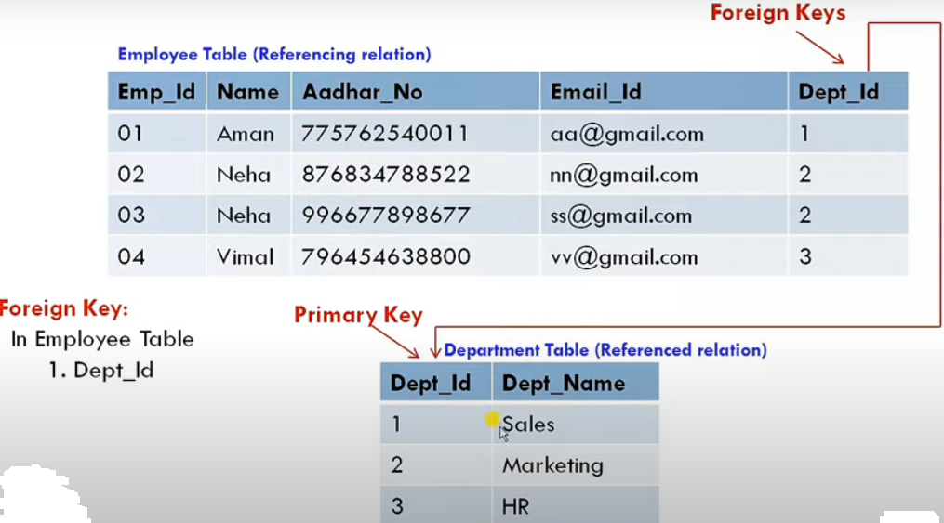

Slide 51
Primary Key | Foreign Key
Helps you to uniquely identify a record in the table. | It is a field in the table that is the primary key of another table.
Primary Key never accept null values. | A foreign key may accept multiple null values.
Primary key is a clustered index and data in the DBMS table are physically organized in the sequence of the clustered index. | A foreign key cannot automatically create an index, clustered or non-clustered. However, you can manually create an index on the foreign key.
You can have the single Primary key in a table. | You can have multiple foreign keys in a table.

Slide 52
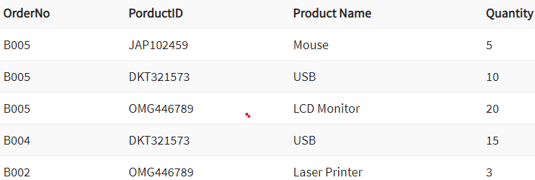
COMPOUND KEY has two or more attributes that allow you to uniquely recognize a specific record. It is possible that each column may not be unique by itself within the database. However, when combined with the other column or columns the combination of composite keys become unique.
The purpose of this key is to uniquely identify each record in the table.
OrderNo and ProductID can’t be a primary key as it does not uniquely identify a record. However, a compound key of Order ID and Product ID could be used as it uniquely identified each record.

Slide 53
COMPOSITE KEY is a combination of two or more columns that uniquely identify rows in a table.
The combination of columns guarantees uniqueness, though individually uniqueness is not guaranteed. Hence, they are combined to uniquely identify records in a table.
The difference between compound and the composite key is that any part of the compound key can be a foreign key, but the composite key may or maybe not a part of the foreign key.

Slide 54
Artificial key / Surrogate key
The key created using arbitrarily assigned data are known as artificial keys.
These keys are created when a primary key is large and complex and has no relationship with many other relations.
The data values of the artificial keys are usually numbered in a serial order (an integer).
This kind of partial key in DBMS is unique because it is created when you don’t have any natural primary key. They do not lend any meaning to the data in the table.
A surrogate key is a value generated right before the record is inserted into a table.
Surrogate keys in sql are allowed when
No property has the parameter of the primary key.
In the table when the primary key is too big or complicated.

Slide 55
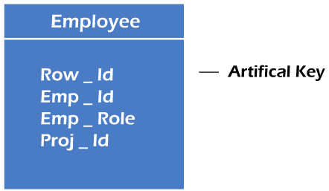
For example, the primary key, which is composed of Emp_ID, Emp_role, and Proj_ID, is large in employee relations. So it would be better to add a new virtual attribute to identify each tuple in the relation uniquely.

Slide 56
Summary
What is key in DBMS: A key in DBMS is an attribute or set of attributes which helps you to identify a row(tuple) in a relation(table)
Keys in RDBMS allow you to establish a relationship between and identify the relation between tables
Eight types of key in DBMS are Super, Primary, Candidate, Alternate, Foreign, Compound, Composite, and Surrogate Key.
A super key is a group of single or multiple keys which identifies rows in a table.
A column or group of columns in a table which helps us to uniquely identifies every row in that table is called a primary key

Slide 57
Summary
All the different keys in DBMS which are not primary key are called an alternate key
A super key with no repeated attribute is called candidate key
A compound key is a key which has many fields which allow you to uniquely recognize a specific record
A key which has multiple attributes to uniquely identify rows in a table is called a composite key
An artificial key which aims to uniquely identify each record is called a surrogate key
Primary Key never accept null values while a foreign key may accept multiple null values.

Slide 58
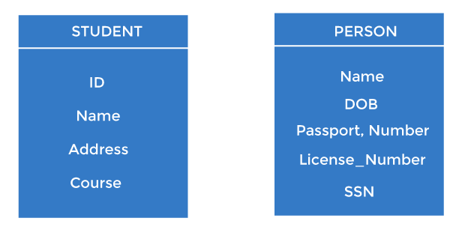
For example, ID is used as a key in the Student table because it is unique for each student. In the PERSON table, passport_number, license_number, SSN are keys since they are unique for each person.

Slide 59
Super Key
A super key is a set of one or more attributes (columns), which can uniquely identify a row in a table.
It supports NULL values
Adding zero or more attributes to the candidate key generates the super key.
A candidate key is a super key but vice versa is not true.

Slide 60
Candidate keys
Candidate keys are selected from the set of super keys, the only thing we take care while selecting candidate key is: It should not have any redundant attribute. That’s the reason they are also termed as minimal super key.
Candidate key is a minimal super key.

Slide 61
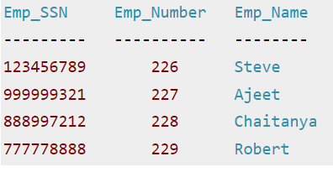
Table: Employee
Super keys: The above table has following super keys. All of the following sets of super key are able to uniquely identify a row of the employee table.
{Emp_SSN}
{Emp_Number}
{Emp_SSN, Emp_Number}
{Emp_SSN, Emp_Name}
{Emp_SSN, Emp_Number, Emp_Name}
{Emp_Number, Emp_Name}

Slide 62
Candidate Keys: Candidate key is a minimal super key with no redundant attributes. The following two set of super keys are chosen from the above sets as there are no redundant attributes in these sets.
{Emp_SSN}
{Emp_Number}
Only these two sets are candidate keys as all other sets are having redundant attributes that are not necessary for unique identification.

Slide 63
Primary key
It is the first key used to identify one and only one instance of an entity uniquely. An entity can contain multiple keys, as we saw in the PERSON table. The key which is most suitable from those lists becomes a primary key.
In the EMPLOYEE table, ID can be the primary key since it is unique for each employee. In the EMPLOYEE table, we can even select License_Number and Passport_Number as primary keys since they are also unique.
For each entity, the primary key selection is based on requirements and developers.

Slide 64
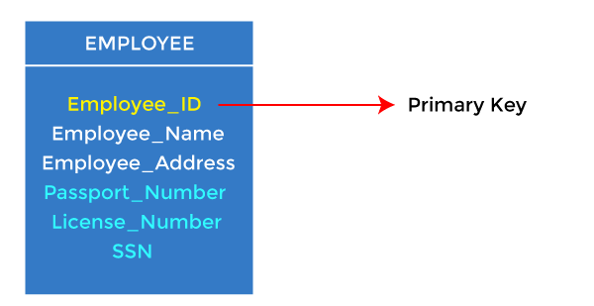

Slide 65
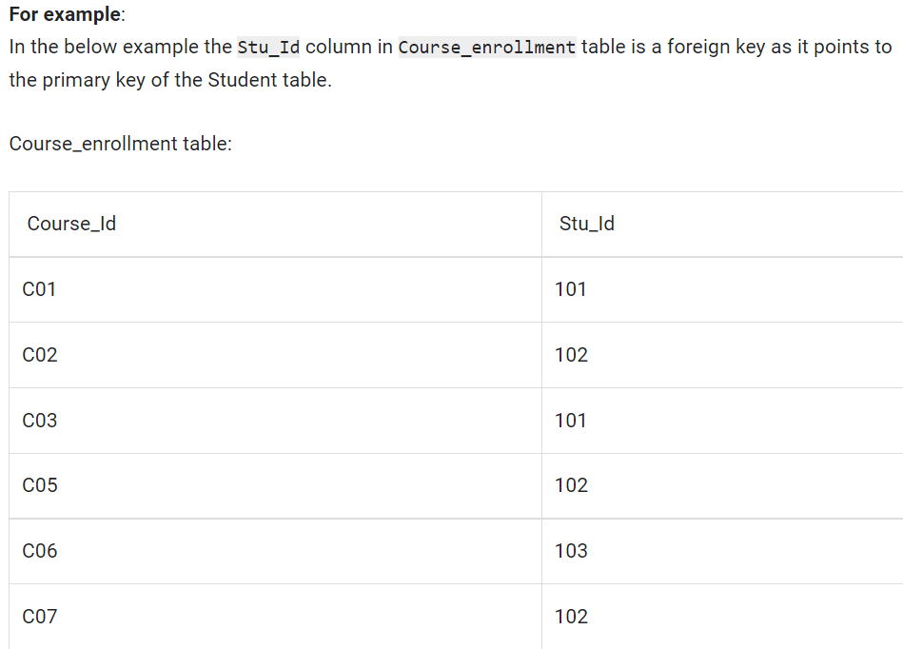
Foreign key in DBMS
Foreign keys are the columns of a table that points to the primary key of another table. They act as a cross-reference between tables.

Slide 66
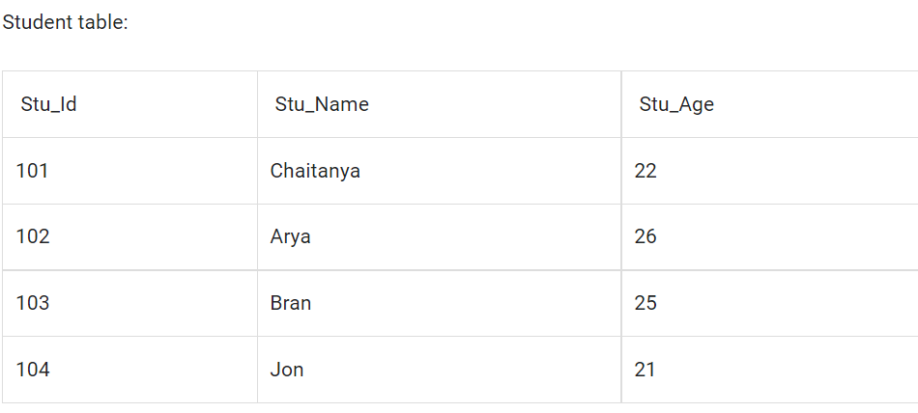

Slide 67
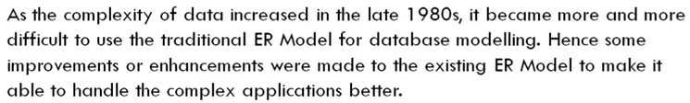
Extended Entity-Relationship (EER) Model: Generalization, Specialization and Aggregation.

Slide 68
Features of EER Model
EER creates a design more accurate to database schemas.
It reflects the data properties and constraints more precisely.
It includes all modeling concepts of the ER model.
Diagrammatic technique helps for displaying the EER schema.
It includes the concept of specialization and generalization.
It is used to represent a collection of objects that is union of objects of different of different entity types.

Slide 69
Superclass: An entity type that represents a general concept at a high level.
Subclass: An entity type that represents a specific concept at lower levels.

Slide 70
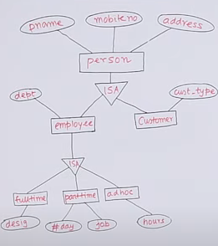
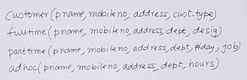

Slide 71
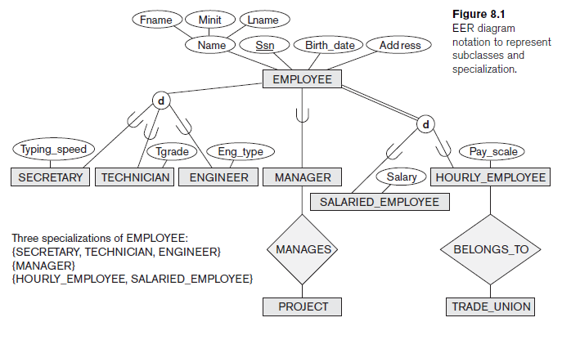

Slide 72
Generalization
Generalization is a process of generalizing an entity which contains generalized attributes or properties of generalized entities. The entity that is created will contain the common features. Generalization is a Bottom up process.
We can have three sub entities as Car, Truck, Motorcycle and these three entities can be generalized into one general super class as Vehicle.
It is a form of abstraction that specifies two or more entities (sub class) having common characters that can be generalized into one single entity (super class) at higher level hiding all the differences.

Slide 73
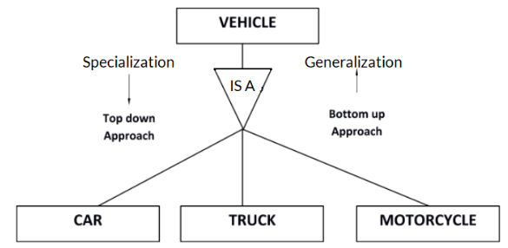

Slide 74
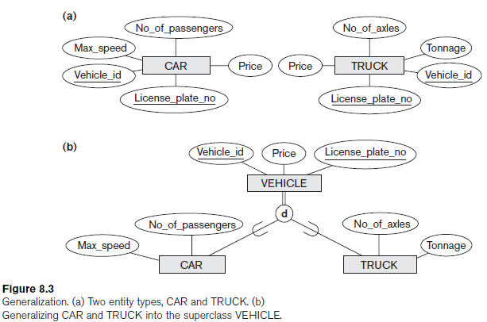

Slide 75
Specialization is a process of identifying subsets of an entity that shares different characteristics.
It breaks an entity into multiple entities from higher level (super class) to lower level (sub class). The breaking of higher level entity is based on some distinguishing characteristics of the entities in super class.
It is a top down approach in which we first define the super class and then sub class and then their attributes and relationships.

Slide 76
The specialization process allows us to do the following:
Define a set of subclasses of an entity type
Establish additional specific attributes with each subclass
Establish additional specific relationship types between each subclass and other entity types or other subclasses

Slide 77

Fig: Instances of Specialization

Slide 78


Slide 79
Association
Association represents the relationship between two classes.
It can be Unidirectional (one way) or Bidirectional (two way).
Unidirectional- Customer places an order.
Bidirectional- A is married to B, B is married to A

Slide 80

Aggregration
Aggregration is a process when relation between two entities is treated as a single entity.
Aggregation represents a has-a relationship between entity types, where one represents the whole and the other the part.
An example of aggregation is the Car and Engine entities. A car is made up of an engine. The car is the whole and the engine is the part.
Aggregation does not represent strong ownership. This means, a part can exist on its own without the whole.
There is no stronger ownership between a car and the engine. An engine of a car can be moved to another car.
In Aggregation, the dependent object is standalone, and can exists even if the object of owning class is dead.

Slide 81

Fig: Aggregation
In the diagram above, the relationship between Center and Course together, is acting as an Entity, which is in relationship with another entity Visitor. Now in real world, if a Visitor or a Student visits a Coaching Center, he/she will never enquire about the center only or just about the course, rather he/she will ask enquire about both.

Slide 82


Slide 83


Slide 84

Composition
Composition is a form of aggregation that represents an association between entities, where there is a strong ownership between the whole and the part.
For example, a tree and a branch have a composition relationship. A branch is 'part' of a 'whole' tree - we cannot cut the branch and add it to another tree.
Representation of composition in ER diagrams
A line with a filled diamond at the end is used to represent composition.

Slide 85



Slide 86


Slide 87


